Slide 1

Finite State Machines
State Minimization
Chapter 5

Slide 2
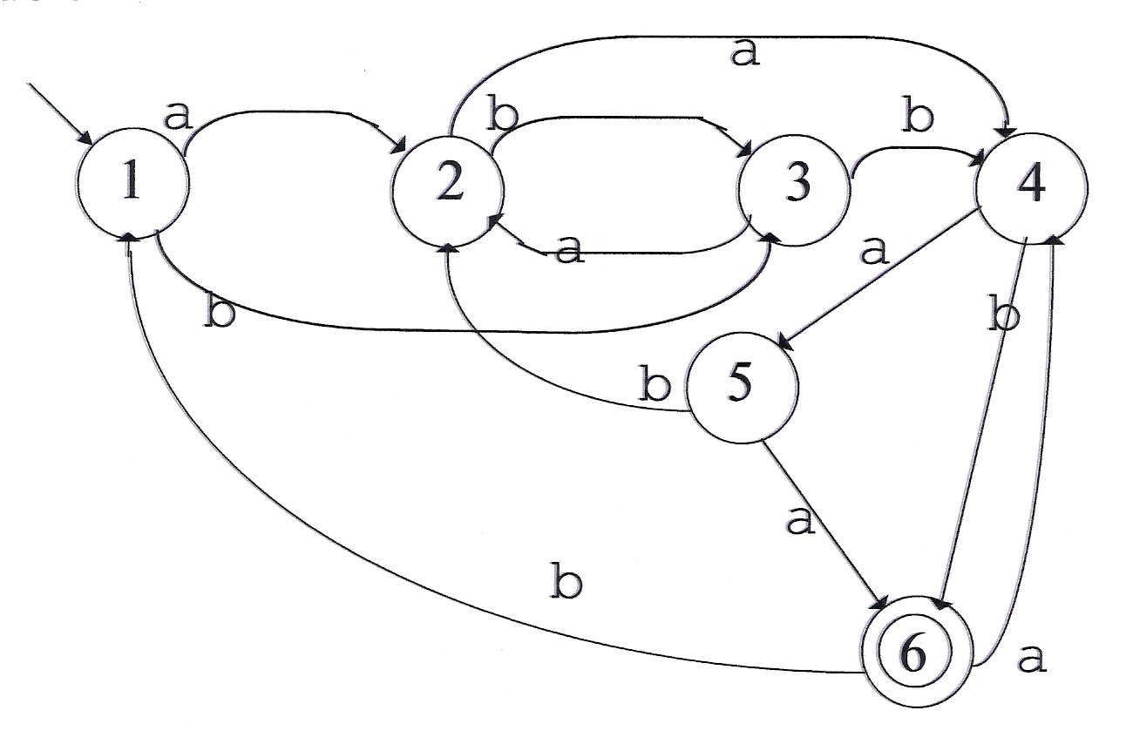
State Minimization
Consider:
Is this a minimal machine?

Slide 3
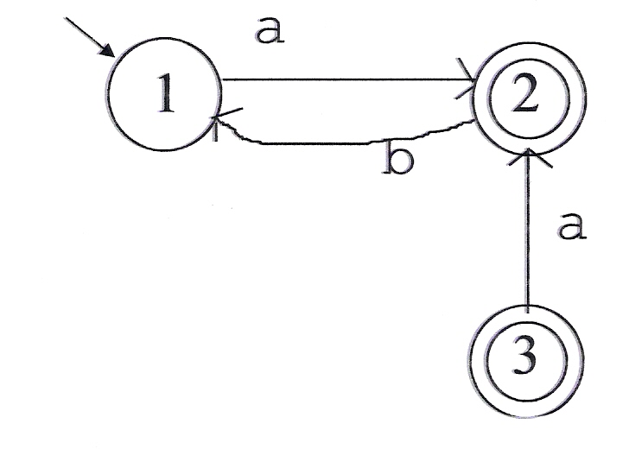
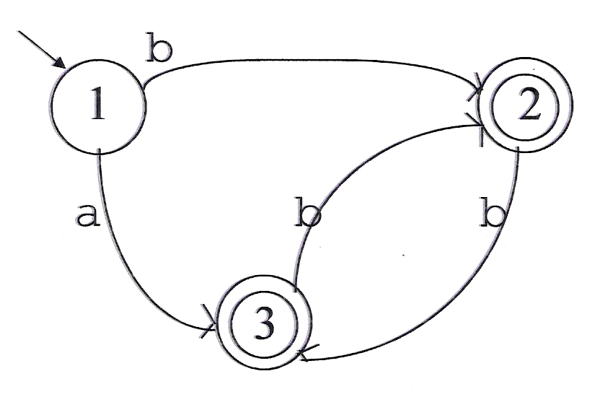
State Minimization
Step (1): Get rid of unreachable states.
State 3 is unreachable.
Step (2): Get rid of redundant states.
States 2 and 3 are redundant.

Slide 4
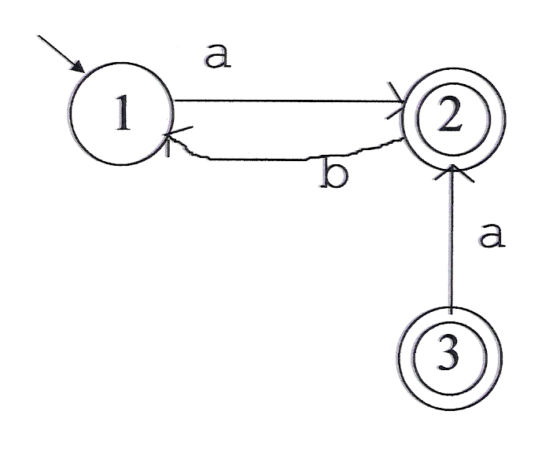
Getting Rid of Unreachable States
We can’t easily find the unreachable states directly. But we can find the reachable ones and determine the unreachable ones from there.
An algorithm for finding the reachable states:

Slide 5
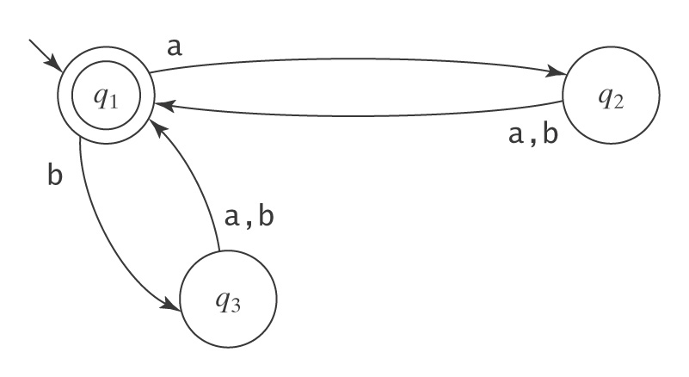
Getting Rid of Redundant States
Intuitively, two states are equivalent to each other (and thus one is redundant) if all strings in Σ* have the same fate, regardless of which of the two states the machine is in. But how can we tell this?
The simple case:
Two states have identical sets of transitions out.

Slide 6
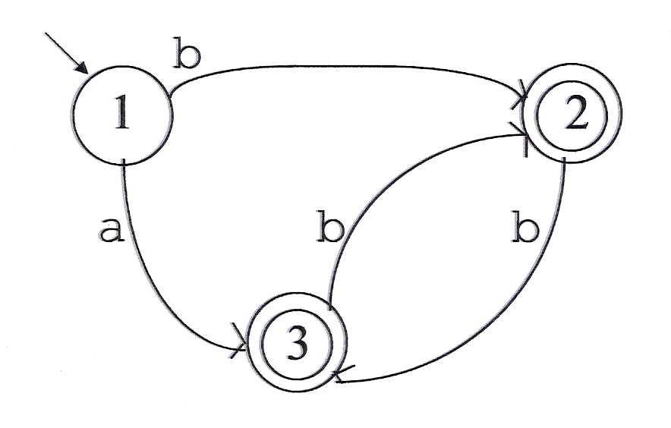
Getting Rid of Redundant States
The harder case:
The outcomes in states 2 and 3 are the same, even though the states aren’t.

Slide 7
Finding an Algorithm
for Minimization
Capture the notion of equivalence classes of strings with respect to a language.
Prove that we can always find a (unique up to state naming) deterministic FSM with a number of states equal to the number of equivalence classes of strings.
Describe an algorithm for finding that deterministic FSM.

Slide 8
Defining Equivalence for Strings
We want to capture the notion that two strings are equivalent or indistinguishable with respect to a language L if, no matter what is tacked on to them on the right, either they will both be in L or neither will. Why is this the right notion? Because it corresponds naturally to what the states of a recognizing FSM have to remember.
Example:
(1) a b a b a b
(2) b a a b a b
Suppose L = {w ∈ {a, b}* : |w| is even}. Are (1) and (2) equivalent?
Suppose L = {w ∈ {a, b}* : every a is immediately followed by b}. Are (1) and (2) equivalent?

Slide 9
Defining Equivalence for Strings
Equivalent, or indistinguishable, string with respect to L:
∀x,y ∈ Σ*: x ≈_{L} y iff ∀z ∈ Σ* (xz ∈ L iff yz ∈ L).

Slide 10
≈_{L} is an Equivalence Relation
≈_{L} is an equivalence relation because it is:
Reflexive: ∀x ∈ Σ* (x ≈_{L} x), because:
∀x, z ∈ Σ* (xz ∈ L ↔ xz ∈ L).
Symmetric: ∀x, y ∈ Σ* (x ≈_{L} y → y ≈_{L} x), because:
∀x, y, z ∈ Σ* ((xz ∈ L ↔ yz ∈ L) ↔
(yz ∈ L ↔ xz ∈ L)).
Transitive: ∀x, y, z ∈ Σ* (((x ≈_{L} y) ∧ (y ≈_{L} w)) → (x ≈_{L} w)),
because:
∀x, y, z ∈ Σ*
(((xz ∈ L ↔ yz ∈ L) ∧ (yz ∈ L ↔ wz ∈ L)) →
(xz ∈ L ↔ wz ∈ L)).

Slide 11
≈_{L} is an Equivalence Relation
Because ≈_{L} is an equivalence relation:
No equivalence class of ≈_{L} is empty.
Each string in Σ* is in exactly one equivalence class of ≈_{L}.

Slide 12
An example of ≈_{L}
Σ = {a, b}
L = {w ∈ Σ* : |w| is even}
The equivalence classes of ≈_{L}:
[ε, aa, ab, ba, bb, aaaa, aaab, …] – even length
[a, b, aaa, aab, aba, abb, …] – odd length

Slide 13
Another example
Σ = {a, b}
L = {w ∈ Σ*: every a is immediately followed by b}
The equivalence classes of ≈_{L}:
[ε, b, abb, …] [all strings in L].
[a, abbba, …] [all strings that end in a and
have no prior a that is not
followed by a b].
[aa, abaa, …] [all strings that contain at least
one instance of aa].

Slide 14
Yet Another Example of ≈_{L}
Σ = {a, b}
L = aab*a
The equivalence classes of ≈_{L}:

Slide 15
When More Than One Class Contains Strings in L
Σ = {a, b}
L = {w ∈ Σ* : no two adjacent characters are the same}
The equivalence classes of ≈_{L}:
[0] [ε]
[1] [a, aba, ababa, …]
[2] [b, ab, bab, abab, …]
[3] [aa, abaa, ababb…]

Slide 16
Does ≈_{L} Always Have a Finite Number of Equivalence Classes?
Σ = {a, b}
L = {a^{n}b^{n}, n ≥ 0}
ε aa aaaa
a aba aaaaa
b aaa
The equivalence classes of ≈_{L}:

Slide 17
The Best We Can Do
Theorem 5.4: Let L be a regular language and let M be a DFSM that accepts L. The number of states in M is greater than or equal to the number of equivalence classes of ≈_{L}.
Proof: Suppose that the number of states in M were less than the number of equivalence classes of ≈_{L}. Then, by the pigeonhole principle, there must be at least one state q that contains strings from at least two equivalence classes of ≈_{L}. But then M’s future behavior on those strings will be identical, which is not consistent with the fact that they are in different equivalence classes of ≈_{L}.

Slide 18
The Best Is Unique
Theorem 5.5: Let L be a regular language over some alphabet Σ. Then there is a DFSM M that accepts L and that has precisely n states where n is the number of equivalence classes of ≈_{L}. Any other FSM that accepts L must either have more states than M or it must be equivalent to M except for state names.
Proof: (by construction)
M = (K, Σ, δ, s, A), where:
● K contains n states, one for each equivalence class of ≈_{L}.
● s = [ε], the equivalence class of ε under ≈_{L}.
● A = {[x] : x ∈ L}.
● δ([x], a) = [xa]. In other words, if M is in the state that
contains some string x, then, after reading the next
symbol, a, it will be in the state that contains xa.

Slide 19
Proof, Continued
We must show that:
K is finite. Since L is regular, it is accepted by some DFSM M′. M′ has some finite number of states m. By Theorem 5.4 (see above), n ≤ m. So K is finite.
δ is a function. In other words, it is defined for all (state, input) pairs and it produces, for each of them, a unique value. The construction defines a value of δ for all (state, input) pairs. The fact that the construction guarantees a unique such value follows from the definition of ≈_{L}.

Slide 20
Proof, Continued
L = L(M). To prove this, we show first that
∀s,t (([ε], st) |-_{M}* ([s], t)).
We do this by induction on |s|.
If |s| = 0 then we have ([ε], εt) |-_{M}* ([ε], t), which is true since M simply makes zero moves.

Slide 21
Proof, Continued
Assume that the claim is true if |s| = k. Then we consider what happens when |s| = k+1. |s| ≥ 1, so we can let s = yc where y ∈ Σ* and c ∈ Σ. We have:
M reads the first k characters:
([ε], yct) |-_{M}* ([y], ct) (induction hypothesis,
since |y| = k).
M reads one more character:
([y], ct) |-_{M}* ([yc], t) (definition of δ_{M}).
Combining those two, after M has read k+1 characters:
([ε], st) = ([ε], yct) |-_{M}* ([y], ct) |-_{M}* ([yc], t) = ([s], t)

Slide 22
Proof, Continued
So we proved :
∀s, t (([ε], st) |-_{M}* ([s], t)).
Let t be ε. Let s be any string in Σ*. By the above:
([ε], s) |-_{M}* ([s], ε).
M accepts s iff [s] ∈ A = {[x] : x ∈ L} iff s ∈ L
So M accepts precisely those strings that are in L, that is, L(M) = L

Slide 23
Proof, Continued
There exists no smaller machine M# that also accepts L. This follows directly from Theorem 5.4 (see above), which says that the number of equivalence classes of ≈_{L} imposes a lower bound on the number of states in any DFSM that accepts L.
There is no different machine M# that also has n states and that accepts L.

Slide 24
Example
L = {w ∈ {a,b}* : no adjacent characters are the same}
equivalence classes of ≈_{L}:
[0] [ε] = start state
[1] [a, ba, aba, baba, …]
[2] [b, ab, bab, abab, …]
[3] [aa, bb, abaa, ababb…]
δ([x], a) = [xa]
a
1
a
0
b
3
a,b
a
b
2
b

Slide 25
The Myhill-Nerode Theorem
Theorem 5.6 (Myhill-Nerode): A language is regular iff the number of equivalence classes of ≈_{L} is finite.
Proof: Show the two directions of the implication:
L regular → the number of equivalence classes of ≈_{L} is finite: If L is regular, then there exists some FSM M that accepts L. M has some finite number of states m. The cardinality of ≈_{L} ≤ m. So the cardinality of ≈_{L} is finite.
The number of equivalence classes of ≈_{L} is finite → L regular: If the cardinality of ≈_{L} is finite, then the construction that was described in the proof of the previous theorem will build an FSM that accepts L. So L must be regular.

Slide 26
So Where Do We Stand?
1. We know that for any regular language L there exists a minimal
accepting machine M_{L}.
2. We know that |K| of M_{L} equals the number of equivalence
classes of ≈_{L}.
3. We know how to construct M_{L} from ≈_{L}.
4. We know that M_{L} is unique up to the naming of its states.
But is this good enough?
Consider:

Slide 27
Minimizing an Existing DFSM
(Without Knowing ≈_{L})
Two approaches:
Begin with M and collapse redundant states, getting rid of one at a time until the resulting machine is minimal.
Begin by overclustering the states of L into just two groups, accepting and nonaccepting. Then iteratively split those groups apart until all the distinctions that L requires have been made.

Slide 28
The Overclustering Approach
We need a definition for “equivalent”, i.e., mergeable states.
Define q ≡ p iff for all strings w ∈ Σ*, either w drives M to an accepting state from both q and p or it drives M to a rejecting state from both q and p.

Slide 29
An Example
Σ = {a, b} L = {w ∈ Σ* : |w| is even}
q₂ ≡ q₃

Slide 30
Constructing ≡ as the Limit of a Sequence of Approximating Equivalence Relations ≡^{n}
(Where n is the length of the input strings that have been considered so far)
Consider input strings, starting with ε, and increasing in length by 1 at each iteration. Start by way overgrouping states. Then split them apart as it becomes apparent (with longer and longer strings) that their behavior is not identical.

Slide 31
Constructing ≡_{n}
p ≡⁰ q iff they behave equivalently when they read ε. In other words, if they are both accepting or both rejecting states.
p ≡¹ q iff they behave equivalently when they read any string of length 1, i.e., if any single character sends both of them to an accepting state or both of them to a rejecting state. Note that this is equivalent to saying that any single character sends them to states that are ≡⁰ to each other.
p ≡² q iff they behave equivalently when they read any string of length 2, which they will do if, when they read the first character they land in states that are ≡¹ to each other. By the definition of ≡¹, they will then yield the same outcome when they read the single remaining character.
And so forth.

Slide 32
Constructing ≡ (cont’d)
More precisely, ∀p,q ∈ K and any n ≥ 1, q ≡^{n} p iff:
1. q ≡^{n-1} p, and
2. ∀a ∈ Σ (δ(p, a) ≡^{n-1} δ(q, a))

Slide 33
MinDFSM
MinDFSM(M: DFSM) =
classes := {A, K-A};
While ∃E ∈ classes, p,q ∈ E, c ∈ Σ with [δ(p,c)] ≠ [δ(q,c)] do
split E such that [p] ≠ [q]
remove E from classes
add the subclasses of E to classes
return M* = (classes, Σ, δ, [s_{M}], {[q]: q ∈ A_{M}]}), where δ_{M*} is constructed as follows:
if δ_{M}(q, c) = p, then δ_{M*}([q], c) = [p]

Slide 34
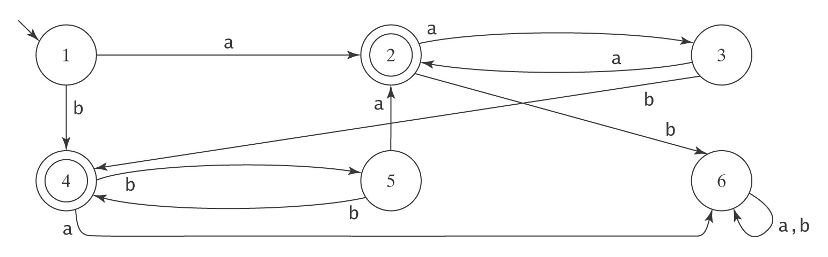
An Example
Σ = {a, b}
≡⁰ = {[1,3,5,6], [2,4]}
≡¹ = {[1,3,5], [6], [2,4]}
≡² = {[1,3,5], [2], [4], [6]}

Slide 35
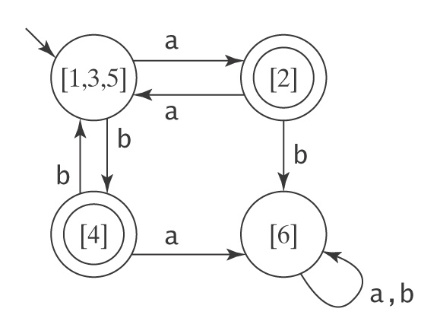
The Result

Slide 36
Summary
● Given any regular language L, there exists a
minimal DFSM M that accepts L.
● M is unique up to the naming of its states.
● Given any DFSM M, there exists an algorithm
minDFSM that constructs a minimal DFSM
that also accepts L(M).

